Slide 1
Big Data Collection & Storage
Mark Korver
Solutions Architect

Slide 2
Agenda
Big Data Reference Architecture
Storage Options & Best Practices
Design Considerations
Putting it all together
Q&A

Slide 3
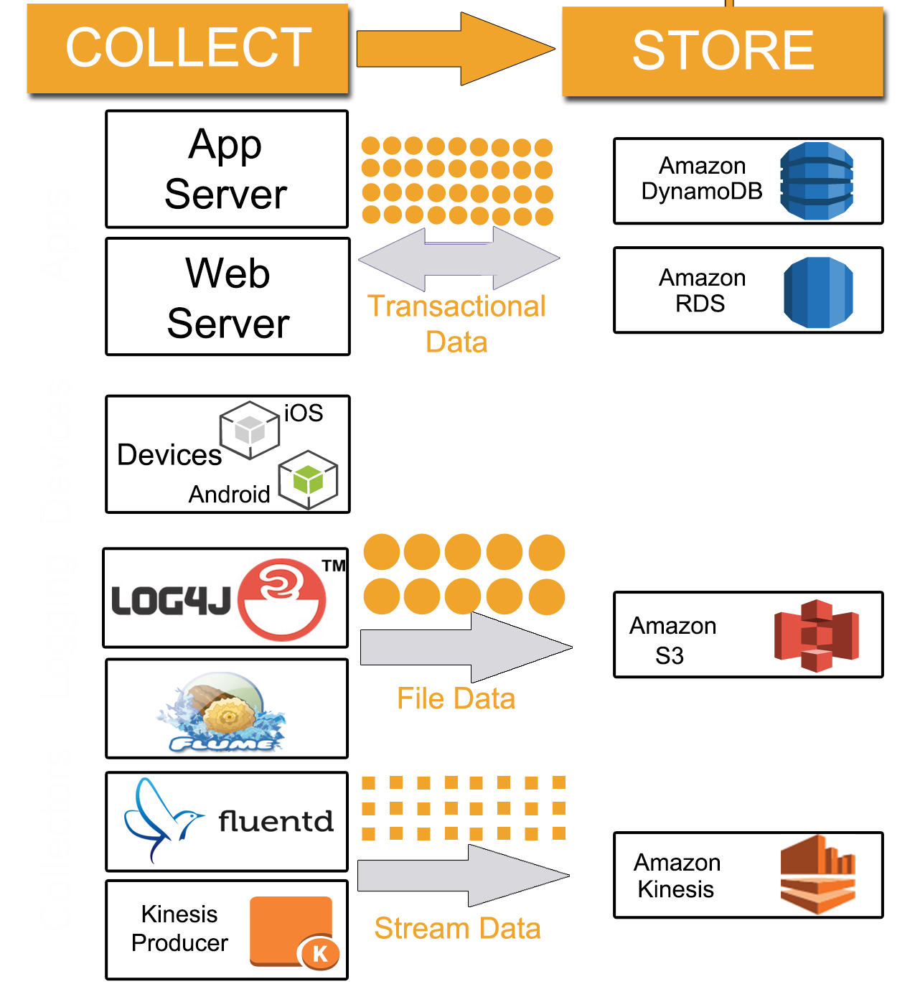
Types of Data
Transactional
OLTP
File
Logs
Stream
IoT

Slide 4
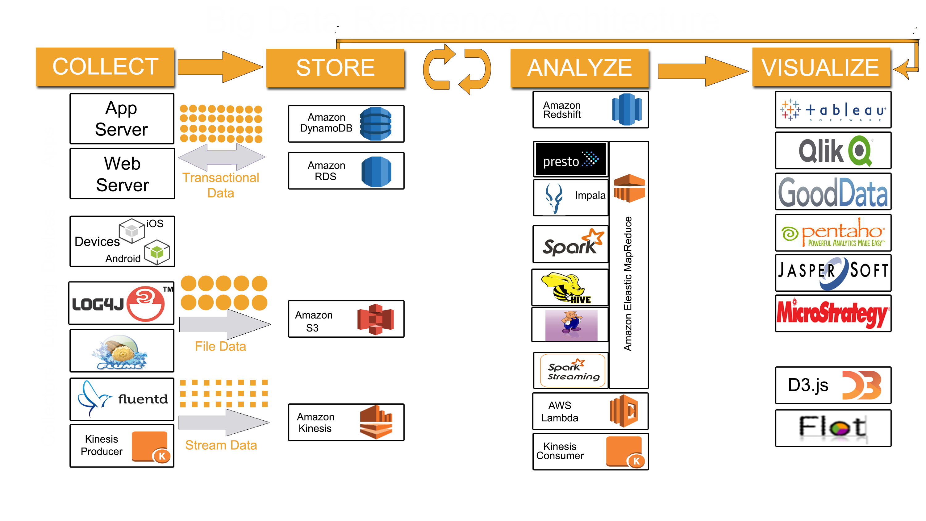

Slide 5
Why Transactional Data Storage?
High throughput
Read, Write, Update intensive
Thousands or Millions of Concurrent interactions
Availability, Speed, Recoverability

Slide 6

NoSQL & NewSQL Solution
Amazon DynamoDB
Amazon RDS for Aurora
3 AZ replication
Unlimited concurrency
No DB size limits
No throughout limits
Key-value, Document, Simple Query
Auto-sharding
3 AZ replication
Thousands of concurrent users per instance + 15 read-replicas
DB size: 64TB
MySQL 5.6 compatible & 5x performance

Slide 7
Amazon DynamoDB
Managed NoSQL database service
Supports both document and key-value data models
Highly scalable – no table size or throughput limits
Consistent, single-digit millisecond latency at any scale
Highly available—3x replication
Simple and powerful API

Slide 8
DynamoDB Table
Table
Items
Attributes
All items for a hash key
==, <, >, >=, <=
“begins with”
“between”
sorted results
counts
top/bottom N values
paged responses
Hash
Key
Range
Key
Mandatory
Key-value access pattern
Determines data distribution
Optional
Model 1:N relationships
Enables rich query capabilities

Slide 9
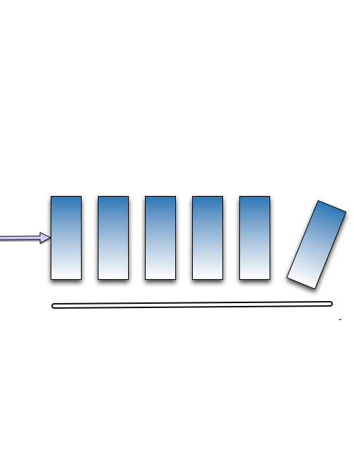
CreateTable
UpdateTable
DeleteTable
DynamoDB API
Table API
New
DescribeTable
ListTables
Stream API
ListStreams
DescribeStream
GetShardIterator
GetItem
Query
Scan
BatchGetItem
Item API
GetRecords
PutItem
UpdateItem
DeleteItem
BatchWriteItem

Slide 10
Data types
String (S)
Number (N)
Binary (B)
String Set (SS)
Number Set (NS)
Binary Set (BS)
Boolean (BOOL)
Null (NULL)
List (L)
Map (M)
Used for storing nested JSON documents

Slide 11
Hash table
Hash key uniquely identifies an item
Hash key is used for building an unordered hash index
Table can be partitioned for scale
Id = 1
Name = Jim
Id = 2
Name = Andy
Dept = Engg
Id = 3
Name = Kim
Dept = Ops
Hash (1) = 7B
Hash (2) = 48
Hash (3) = CD
00
Key Space
FF
00
54
55
A9
AA
FF

Slide 12
Partitions are three-way replicated
Id = 2
Name = Andy
Dept = Engg
Id = 1
Name = Jim
Id = 3
Name = Kim
Dept = Ops
Replica 1
Id = 2
Name = Andy
Dept = Engg
Id = 1
Name = Jim
Id = 3
Name = Kim
Dept = Ops
Replica 2
Id = 2
Name = Andy
Dept = Engg
Id = 1
Name = Jim
Id = 3
Name = Kim
Dept = Ops
Replica 3
Partition 1
Partition 2
Partition N

Slide 13
Hash-range table
Hash key and range key together uniquely identify an Item
Within unordered hash index, data is sorted by the range key
No limit on the number of items (∞) per hash key
Except if you have local secondary indexes
Partition 1
Partition 2
Partition 3
00:0
54:∞
55
A9:∞
AA
FF:∞
Customer# = 2
Order# = 10
Item = Pen
Customer# = 1
Order# = 10
Item = Toy
Customer# = 3
Order# = 10
Item = Book
Customer# = 2
Order# = 11
Item = Shoes
Customer# = 1
Order# = 11
Item = Boots
Customer# = 3
Order# = 11
Item = Paper
Hash (2) = 48
Hash (1) = 7B
Hash (3) = CD

Slide 14
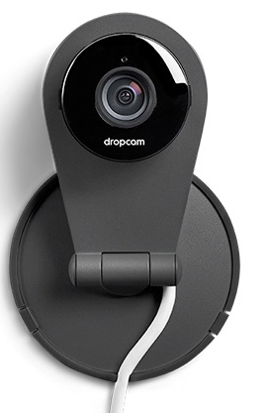

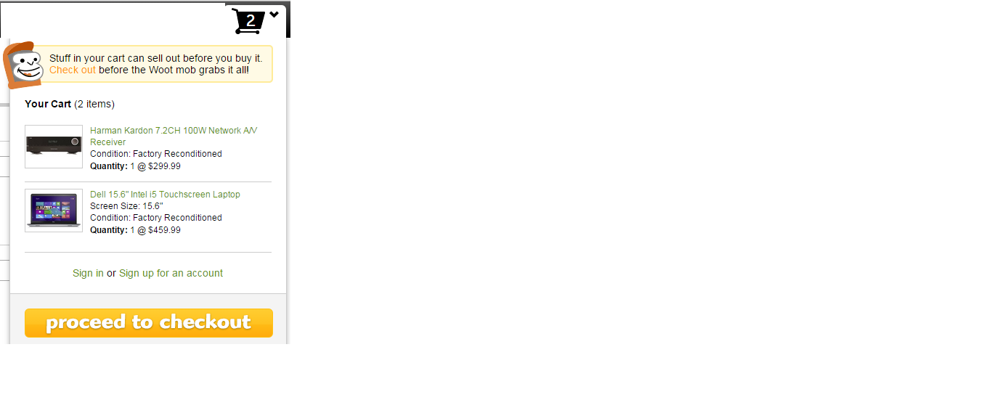

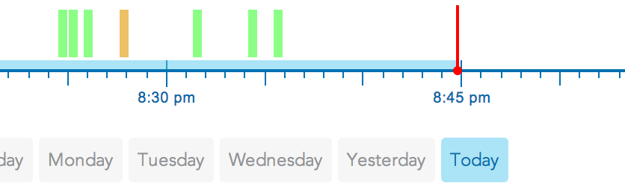
DynamoDB table examples
case class CameraRecord(
cameraId: Int, // hash key
ownerId: Int,
subscribers: Set[Int],
hoursOfRecording: Int,
...
)
case class Cuepoint(
cameraId: Int, // hash key
timestamp: Long, // range key
type: String,
...
)
HashKey | RangeKey | Value
Key | Segment | 1234554343254
Key | Segment1 | 1231231433235

Slide 15
Local Secondary Index (LSI)
alternate range key + same hash key
index and table data is co-located (same partition)
10 GB max per hash key, i.e. LSIs limit the # of range keys!

Slide 16
Global Secondary Index
any attribute indexed as new hash and/or range key
Online indexing
RCUs/WCUs provisioned separately for GSIs

Slide 17
LSI or GSI?
LSI can be modeled as a GSI
If data size in an item collection > 10 GB, use GSI
If eventual consistency is okay for your scenario, use GSI!

Slide 18
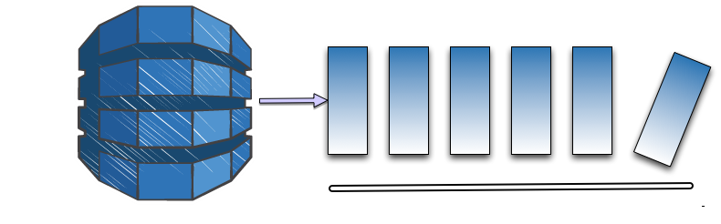

DynamoDB Streams
Stream of updates to a table
Asynchronous
Exactly once
Strictly ordered
Per item
Highly durable
Scale with table
24-hour lifetime
Sub-second latency

Slide 19
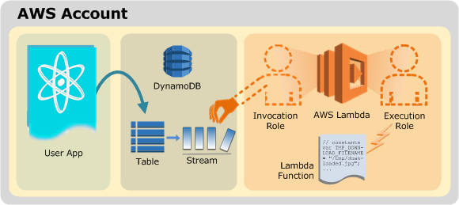
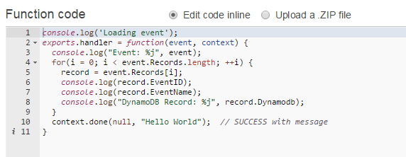
DynamoDB Streams and AWS Lambda

Slide 20
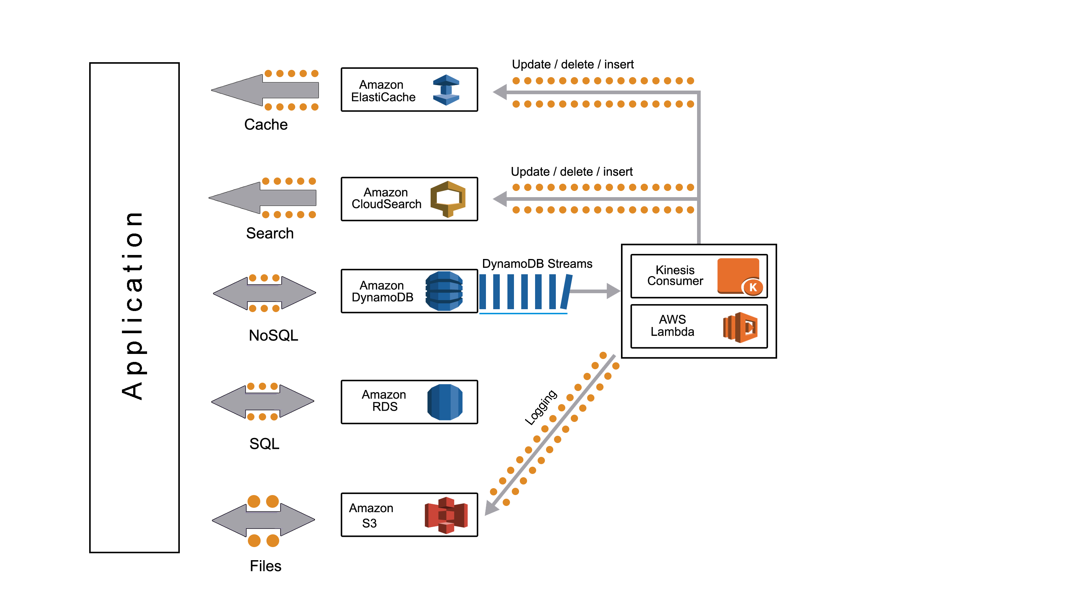
Emerging Architecture Pattern

Slide 21
Scaling
Throughput
Provision any amount of throughput to a table
Size
Add any number of items to a table
Max item size is 400 KB
LSIs limit the number of range keys due to 10 GB limit
Scaling is achieved through partitioning

Slide 22
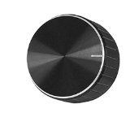
Throughput
Provisioned at the table level
Write capacity units (WCUs) are measured in 1 KB per second
Read capacity units (RCUs) are measured in 4 KB per second
RCUs measure strictly consistent reads
Eventually consistent reads cost 1/2 of consistent reads
Read and write throughput limits are independent
RCU
WCU

Slide 23
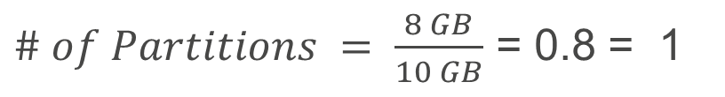
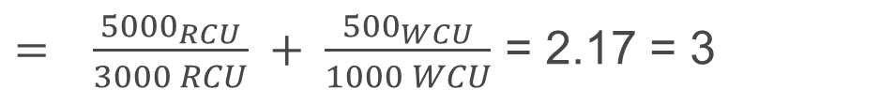
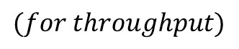
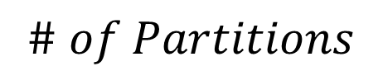
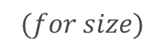
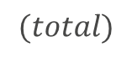
Partitioning example
Table size = 8 GB, RCUs = 5000, WCUs = 500
$$\# of Partitions$$
$= \frac{{5000}_{RCU}}{3000 RCU} + \frac{{500}_{WCU}}{1000 WCU}$ = 2.17 = 3
$$(for throughput)$$
$\# of Partitions = \frac{8 GB}{10 GB}$ = 0.8 = 1
$$(for size)$$
$\# of Partitions=\operatorname{MAX}\left(1 for size | 3 for throughput\right)$ = 3
$$(total)$$
RCUs and WCUs are uniformly spread across partitions
RCUs per partition = 5000/3 = 1666.67
WCUs per partition = 500/3 = 166.67
Data/partition = 10/3 = 3.33 GB

Slide 24
DynamoDB Best Practices

Slide 25
Amazon DynamoDB Best Practices
Keep item size small
Store metadata in Amazon DynamoDB and large blobs in Amazon S3
Use a table with a hash key for extremely high scale
Use table per day, week, month etc. for storing time series data
Use conditional updates for de-duping
Use hash-range table and/or GSI to model
1:N, M:N relationships
Avoid hot keys and hot partitions
Events_table_2012
Event_id (Hash key) | Timestamp (range key) | Attribute1 | …. | Attribute N
Events_table_2012_05_week1
Event_id (Hash key) | Timestamp (range key) | Attribute1 | …. | Attribute N
Events_table_2012_05_week2
Event_id (Hash key) | Timestamp (range key) | Attribute1 | …. | Attribute N
Events_table_2012_05_week3
Event_id (Hash key) | Timestamp (range key) | Attribute1 | …. | Attribute N

Slide 26
Additional references
Deep Dive: Amazon DynamoDB
www.youtube.com/watch?v=VuKu23oZp9Q
http://www.slideshare.net/AmazonWebServices/deep-dive-amazon-dynamodb

Slide 27

Amazon S3
Amazon S3 is for storing objects (like “files”)
Objects are stored in buckets
A bucket keeps data in a single AWS Region, replicated across multiple facilities
Cross-Region Replication
Highly durable, highly available, highly scalable
Secure
Designed for 99.999999999% durability

Slide 28
Why is Amazon S3 good for Big Data?
Separation of compute and storage
Unlimited number of objects
Object size up to 5TB
Very high bandwidth
Supports versioning and lifecycle policies
Integrated with Amazon Glacier

Slide 29



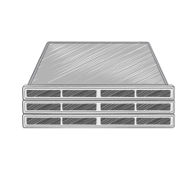



Amazon S3 event notifications
Delivers notifications to SNS, SQS, or AWS Lambda
S3
SNS topic
Notifications
Notifications
SQS queue
Events
Notifications
Lambda function
Foo() {
…
}

Slide 30
Server-side encryption options
SSE with Amazon S3 managed keys
“Check-the-box” to encrypt your data at rest
SSE with customer provided keys
You manage your encryption keys and provide them for PUTs and GETS
SSE with AWS Key Management Service
AWS KMS provides central management, permission controls and usage auditing

Slide 31
Versioning
Protects from accidental overwrites and deletes with no performance penalty
Generates a new version with every upload
Allows easily retrieval of deleted objects or roll back to previous versions
Three states of an Amazon S3 bucket
Default – Un-versioned
Versioning-enabled
Versioning-suspended

Slide 32
Lifecycle policies
Provides automatic tiering to a different storage class and cost control
Includes two possible actions:
Transition: archives to Amazon Glacier after a specified amount of time
Expiration: deletes objects after a specified amount of time
Allows for actions to be combined – archive and then delete
Supports lifecycle control at the prefix level

Slide 33
Amazon S3 Best Practices

Slide 34
Best practices
Reduced Redundancy Storage (RRS) for low-cost storage of derivatives or copies
Generate a random hash prefix for keys (>100 TPS)
examplebucket/232a-2013-26-05-15-00-00/cust1234234/log1.gz
examplebucket/7b54-2013-26-05-15-00-00/cust3857422/log2.gz
examplebucket/921c-2013-26-05-15-00-00/cust1248473/log3.gz
Use parallel threads and multipart upload for faster writes
Use parallel threads and range GET for faster reads

Slide 35
File Best Practices
Compress data files
Reduces Bandwidth
Avoid small files
Hadoop mappers proportional to number of files
S3 PUT cost quickly adds up
Algorithm | % Space Remaining | Encoding Speed | Decoding Speed
GZIP | 13% | 21MB/s | 118MB/s
LZO | 20% | 135MB/s | 410MB/s
Snappy | 22% | 172MB/s | 409MB/s

Slide 36
Dealing with Small Files
Use S3DistCP to combine smaller files together
S3DistCP takes a pattern and target path to combine smaller input files to larger ones
"--groupBy,.*XABCD12345678.([0-9]+-[0-9]+-[0-9]+-[0-9]+).*“
Supply a target size and compression codec
"--targetSize,128",“--outputCodec,lzo"
s3://myawsbucket/cf/XABCD12345678.2012-02-23-01.HLUS3JKx.gz
s3://myawsbucket/cf/XABCD12345678.2012-02-23-01.I9CNAZrg.gz
s3://myawsbucket/cf/XABCD12345678.2012-02-23-02.YRRwERSA.gz
s3://myawsbucket/cf/XABCD12345678.2012-02-23-02.dshVLXFE.gz
s3://myawsbucket/cf/XABCD12345678.2012-02-23-02.LpLfuShd.gz
s3://myawsbucket/cf1/2012-02-23-01.lzo
s3://myawsbucket/cf1/2012-02-23-02.lzo

Slide 37






Transferring data into Amazon S3
Internet
Amazon S3
Corporate Data Center
AWS Direct Connect
Amazon EC2
Availability Zone
AWS Region
AWS Import/ Export

Slide 38



AWS partners for data transfer to Amazon S3

Slide 39
AWS Big Data Blog
Using AWS for Multi-instance, Multi-part Uploads
Moving Big Data into the Cloud with Tsunami UDP
Moving Big Data Into The Cloud with ExpeDat Gateway for Amazon S3

Slide 40

Why Stream Storage?
Decouple producers & consumers
Temporary buffer
Preserve client ordering
Streaming MapReduce
Producer 1
4 | 3 | 2 | 1
Key = Red
Amazon Kinesis
Consumer 1
Count of Red = 4
4 | 3 | 2 | 1
Key = Green
Shard or Partition 1
4 | 4 | 3 | 3 | 2 | 2 | 1 | 1
Producer 2
Count of Violet = 4
Key = Blue
Producer 3
4 | 3 | 2 | 1
Shard or Partition 2
4 | 4 | 3 | 3 | 2 | 2 | 1 | 1
Consumer 2
Key = Violet
Count of Blue = 4
Producer N
4 | 3 | 2 | 1
Count of Green = 4

Slide 41
Amazon Kinesis Managed Service for streaming data ingestion, and processing

Slide 42








Sending & Reading Data from Kinesis Streams
Sending
Consuming
HTTP Post
Get* APIs
AWS SDK
Kinesis Client Library
+
Connector Library
AWS Mobile SDK
Apache Storm
LOG4J
Flume
Amazon Elastic MapReduce
Fluentd

Slide 43
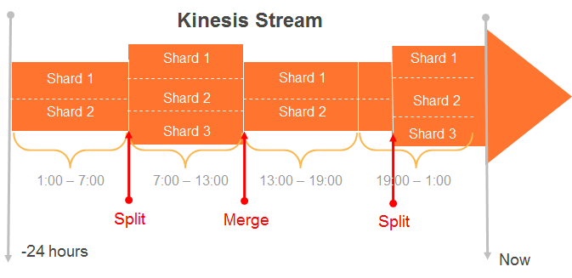
Kinesis Stream & Shards
Streams are made of Shards
Each Shard ingests data up to 1MB/sec, and up to 1000 TPS
Each Shard emits up to 2 MB/sec
All data is stored for 24 hours
Scale Kinesis streams by splitting or merging Shards
Replay data inside of 24Hr. Window

Slide 44
How to Size your Kinesis Stream - Ingress
Suppose 2 Producers, each producing 2KB records at 500 KB/s:
Minimum Requirement: Ingress Capacity of 2 MB/s, Egress Capacity of 2MB/s
A theoretical minimum of 2 shards is required which will provide an ingress capacity of 2MB/s, and egress capacity 4 MB/s
2 KB * 500 TPS = 1000KB/s
1 MB/S
Shard
1 MB/S
Payment Processing Application
2 KB * 500 TPS = 1000KB/s
1 MB/S
Shard
1 MB/S
Producers
Theoretical Minimum of 2 Shards Required

Slide 45
How to Size your Kinesis Stream - Egress
Records are durably stored in Kinesis for 24 hours, allowing for multiple consuming applications to process the data
Let’s extend the same example to have 3 consuming applications:
If all applications are reading at the ingress rate of 1MB/s per shard, an aggregate read capacity of 6 MB/s is required, exceeding the shard’s egress limit of 4MB/s
Solution: Simple! Add another shard to the stream to spread the load
1 MB/S
Payment Processing Application
2 KB * 500 TPS = 1000KB/s
Shard
1 MB/S
Fraud Detection Application
2 KB * 500 TPS = 1000KB/s
Shard
Recommendation Engine Application
Producers
Egress Bottleneck

Slide 46
Resizing?
MergeShards | Takes two adjacent shards in a stream and combines them into a single shard to reduce the stream's capacity | X-Amz-Target: Kinesis_20131202.MergeShards { "StreamName": "exampleStreamName", "ShardToMerge": "shardId-000000000000", "AdjacentShardToMerge": "shardId-000000000001" }
SplitShard | Splits a shard into two new shards in the stream, to increase the stream's capacity | X-Amz-Target: Kinesis_20131202.SplitShard { "StreamName": "exampleStreamName", "ShardToSplit": "shardId-000000000000", "NewStartingHashKey": "10" }
Both are online operations

Slide 47
Putting Data into Kinesis
Simple Put interface to store data in Kinesis
Producers use PutRecord or PutRecords call to store data in a Stream.
Each record <= 50KB
PutRecord {Data, StreamName, PartitionKey}
A Partition Key is supplied by producer and used to distribute the PUTs across Shards
Kinesis MD5 hashes supplied partition key over the hash key range of a Shard
A unique Sequence # is returned to the Producer upon a successful call

Slide 48
Kinesis Best Practices

Slide 49
PutRecord Vs PutRecords
Use PutRecords when producers creates a large number of records
50KB per records, Max 500 records or 4.5MB
Sending batches is more efficient (better IO, threading) than sending singletons
Can’t use SequenceNumberForOrdering i.e. not way of ordering records within a batch
Use PutRecord when producers don’t create a large number of records
Can use SequenceNumberForOrdering

Slide 50
Determine Your Partition Key Strategy
Kinesis as a managed buffer or a streaming map-reduce?
Ensure a high cardinality for Partition Keys with respect to shards, to prevent a “hot shard” problem
Generate Random Partition Keys
Streaming Map-Reduce: Leverage Partition Keys for business specific logic as applicable
Partition Key per billing customer, per DeviceId, per stock symbol

Slide 51
Provisioning Adequate Shards
For ingress needs
Egress needs for all consuming applications: If more than 2 simultaneous consumers
Include head-room for catching up with data in stream in the event of application failures

Slide 52
Pre-Batch before Puts for better efficiency
Consider FluentD, Flume as collectors/ agents
Generates random partition keys
Set number of threads to buffer
https://github.com/awslabs/aws-fluent-plugin-kinesis
Consider Async producer – present in AWS SDK
Default ThreadPoolExecutor runs 50 threads to execute requests
If not enough: use SynchronousQueue or ArrayBlockingQueue

Slide 53
Pre-Batch before Puts for better efficiency
# KINESIS appender
log4j.logger.KinesisLogger=INFO, KINESIS
log4j.additivity.KinesisLogger=false
log4j.appender.KINESIS=com.amazonaws.services.kinesis.log4j.KinesisAppender
# DO NOT use a trailing %n unless you want a newline to be transmitted to KINESIS after every message
log4j.appender.KINESIS.layout=org.apache.log4j.PatternLayout
log4j.appender.KINESIS.layout.ConversionPattern=%m
# mandatory properties for KINESIS appender
log4j.appender.KINESIS.streamName=testStream
#optional, defaults to UTF-8
log4j.appender.KINESIS.encoding=UTF-8
#optional, defaults to 3
log4j.appender.KINESIS.maxRetries=3
#optional, defaults to 2000
log4j.appender.KINESIS.bufferSize=1000
#optional, defaults to 20
log4j.appender.KINESIS.threadCount=20
#optional, defaults to 30 seconds
log4j.appender.KINESIS.shutdownTimeout=30
Make a tweak to your existing logging
log4j appender option
https://github.com/awslabs/kinesis-log4j-appender

Slide 54
Dealing with ProvisionedThroughputExceeded Exceptions
Retry if rise in input rate is temporary
Reshard to increase number of shards
Monitor CloudWatch metrics: PutRecord.Bytes and GetRecords.Bytes metrics keep track of shard usage
Metric | Units
PutRecord.Bytes | Bytes
PutRecord.Latency | Milliseconds
PutRecord.Success | Count
Keep track of your metrics
Log hashkey values generated by your partition keys
Log Shard-Ids
Determine which Shard receive the most (hashkey) traffic.
putRecordRequest.setPartitionKey
(String.format( "myPartitionKey"));
String shardId = putRecordResult.getShardId();

Slide 55
Auto-Scaling Kinesis Shards
Options:
stream-name - The name of the Stream to be scaled
scaling-action - The action to be taken to scale. Must be one of "scaleUp”, "scaleDown" or “resize"
count - Number of shards by which to absolutely scale up or down, or resize to or:
pct - Percentage of the existing number of shards by which to scale up or down
java -cp KinesisScalingUtils.jar-complete.jar -Dstream-name=MyStream -Dscaling-action=scaleUp -Dcount=10 -Dregion=eu-west-1
https://github.com/awslabs/amazon-kinesis-scaling-utils

Slide 56
Cost Conscious Design

Slide 57
Cost Conscious Design Example: Should I use Amazon S3 or Amazon DynamoDB?
“I’m currently scoping out a project that will greatly increase my team’s use of Amazon S3. Hoping you could answer some questions. The current iteration of the design calls for many small files, perhaps up to a billion during peak. The total size would be on the order of 1.5 TB per month…”
Request rate (Writes/sec) | Object size (Bytes) | Total size (GB/month) | Objects per month
300 | 2048 | 1483 | 777,600,000

Slide 58

Cost Conscious Design Example: Should I use Amazon S3 or Amazon DynamoDB?

Slide 59
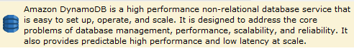
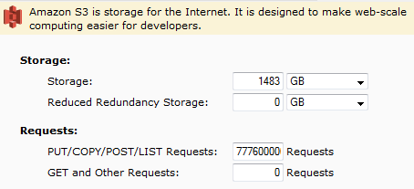
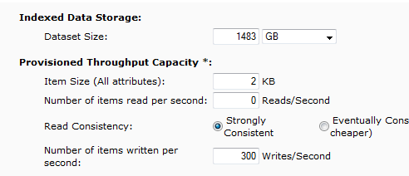
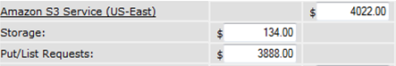
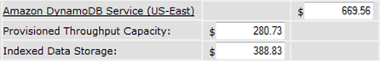
Request rate (Writes/sec) | Object size (Bytes) | Total size (GB/month) | Objects per month
300 | 2,048 | 1,483 | 777,600,000
Amazon S3 or
Amazon DynamoDB?

Slide 60
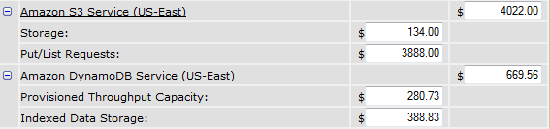
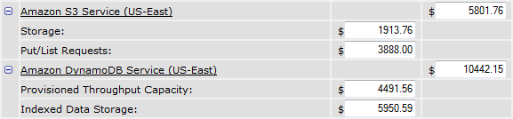
Amazon DynamoDB
use
 | Request rate (Writes/sec) | Object size (Bytes) | Total size (GB/month) | Objects per month
Scenario 1 | 300 | 2,048 | 1,483 | 777,600,000
Scenario 2 | 300 | 32,768 | 23,730 | 777,600,000
use
Amazon S3

Slide 61
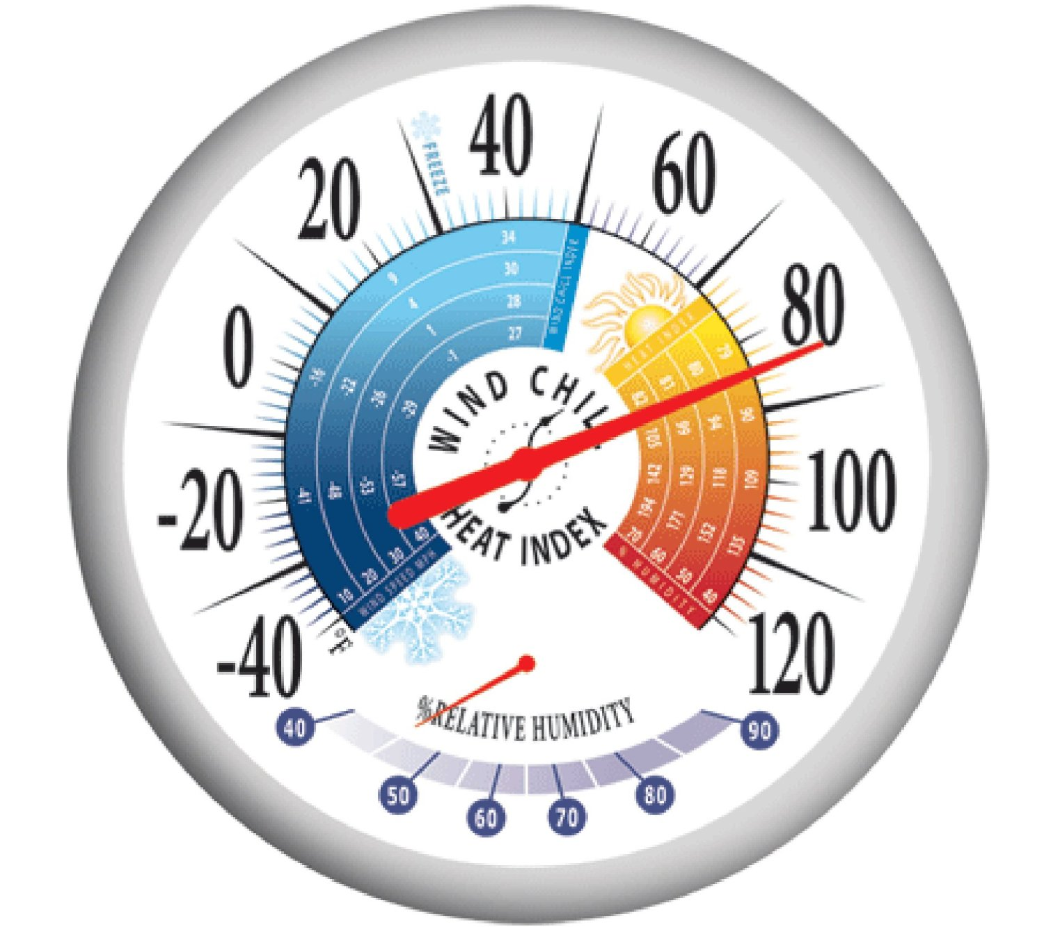
What is the temperature of your data?

Slide 62
Data Characteristics: Hot, Warm, Cold
 | Hot | Warm | Cold
Volume | MB–GB | GB–TB | PB
Item size | B–KB | KB–MB | KB–TB
Latency | ms | ms, sec | min, hrs
Durability | Low–High | High | Very High
Request rate | Very High | High | Low
Cost/GB | $$-$ | $-¢¢ | ¢

Slide 63
Low
Amazon S3
Amazon Glacier
Amazon
Kinesis
Structure
Amazon DynamoDB
Amazon RDS
Amazon Redshift
High
High
Low
Request rate
High
Low
Cost/GB
Low
High
Latency
Low
High
Data Volume

Slide 64
Putting it all together

Slide 65
ADV402 Beating the Speed of Light With Your Infrastructure in AWS
Valentino Volonghi, CTO, AdRoll
Siva Raghupathy, Principal Solutions Architect, AWS
November 14, 2014 | Las Vegas, NV

Slide 66

60 billion requests/day

Slide 67
We
Must
Stay
Up
1% downtime
=
>$1M

Slide 68

No
Infinitely
Deep
Pockets

Slide 69

100ms MAX Latency

Slide 70


Paris-New York: ~6000km
Speed of Light in fiber: 200,000 km/s
RTT latency without hops and copper: 60ms
Paris-New York: ~6000km
Speed of Light in fiber: 200,000 km/s
RTT latency without hops and copper: 60ms
6000
km
60 ms
c-RTT

Slide 71

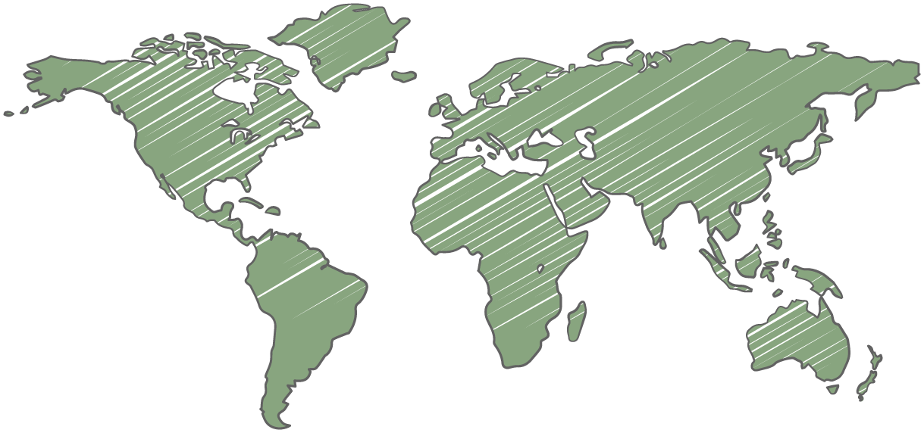
Global Presence

Slide 72
Needed a few specific things
Handle 150TB/day
Low <5ms response time
1,000,000+ global requests/second
100B items

Slide 73
AdRoll AWS Architecture
Solution
Data Collection
Amazon EC2, Elastic Load Balancing, Auto Scaling
Store
Amazon S3 + Amazon Kinesis
Global Distribution
Apache Storm on Amazon EC2
Bid Store
DynamoDB
Bidding
Amazon EC2, Elastic Load Balancing, Auto Scaling

Slide 74
Batch & Speed Layer
Data Collection = Batch Layer
Bidding = Speed Layer
minutes
milliseconds
Data Collection
Data Storage
Global
Distribution
Bid Storage
Bidding

Slide 75


Data Collection & Bidding
Data Collection
Bidding
Elastic Load Balancing
Elastic Load Balancing
Auto Scaling group
Auto Scaling group
instances
instances
Availability Zone
Availability Zone
Availability Zone
Availability Zone
Amazon Kinesis
Amazon S3
Apache Storm
DynamoDB
US East region

Slide 76
Summary
Use the right tool for the job!
Amazon DynamoDB or Amazon RDS for transactional data
Amazon S3 for file data
Amazon Kinesis for Streaming data
Be cost conscious!

